Slide 1
Statistical Modeling to Predict Credit Approval
Aaron Beach, Bharadwaj Kopparthi, Sidra Husain, Trang Doan, Xiaojie Yu
Team # 12
MGT 6203
Summer 2023

Slide 2
Presentation Outline
Background Introduction
Dataset Introduction and Exploration
Variable Selection
Logistic Regression
Neural Network
Conclusion

Slide 3
Introduction
Credit
A agreement between a borrower and a lender
The trust the allows one party to lend money or resources to another party
Why is credit important?
Individual: Convenient; opportunity for wealth growth
Company: Balance risk vs. return; Improve profitability
Nation: Stimulate economy growth
Notes:
According to investopedia, Credit represents an agreement between a creditor (lender) and a borrower (debtor). The debtor promises to repay the lender, often with interest, or risk financial or legal penalties.
Business needs credit to facilitate business activity, spend on capital expenditures, create jobs and thus indirectly stimulate the economy. Individuals need credit to fund major expenses, such as: education, real estates, autos, etc. Therefore, it is very important to facilitate lending in the economy without incurring excessive risks.

Slide 4
Project Objectives
Credit Application
Evaluation
Decision
What are the significant factors involved in credit decision process?
How are these factors influence credit decisions?
Can we use these factors to predict credit decisions?
What analytic models can be used for the prediction?

Slide 5
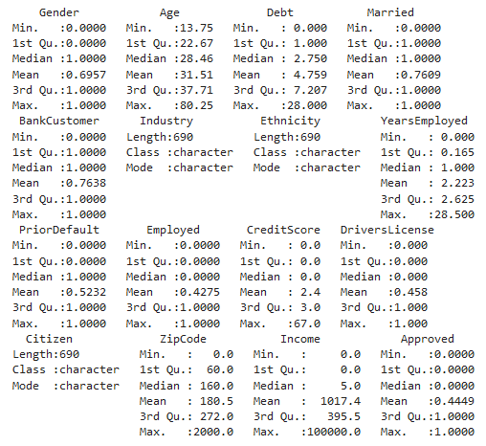
Dataset Exploration
Download Dataset
Figure 1. Independent Variables

Slide 6
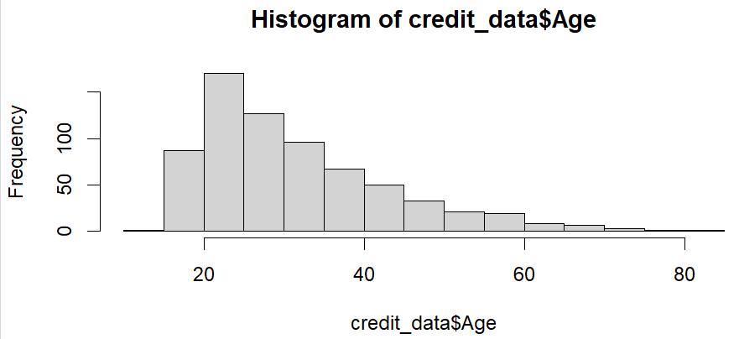
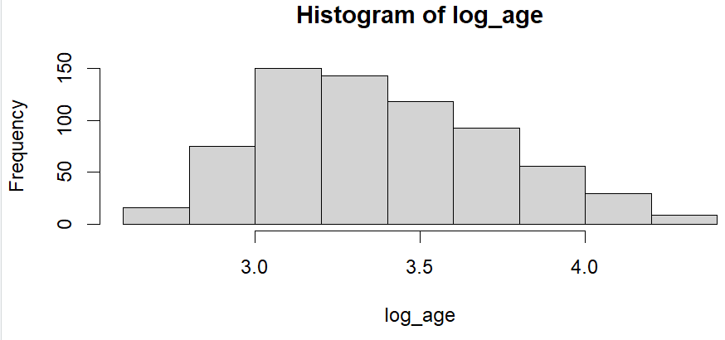
Dataset Exploratory (Cont.’)

Slide 7
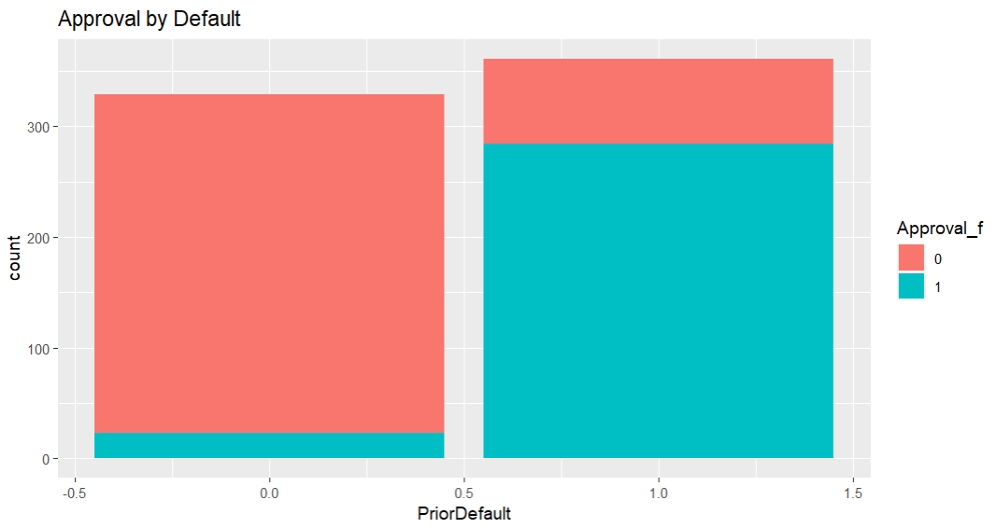
Dataset Exploration(cont’)
PriorDefault vs. Approval

Slide 8
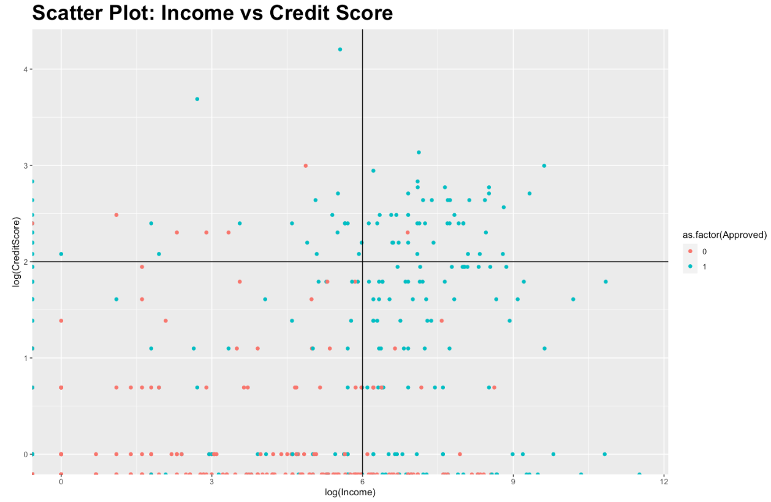
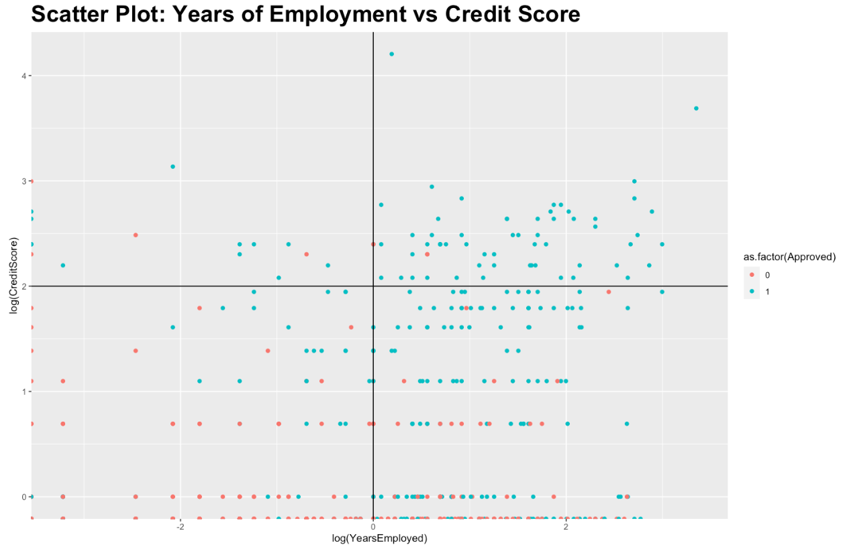
Dataset exploration(Cont.’)

Slide 9
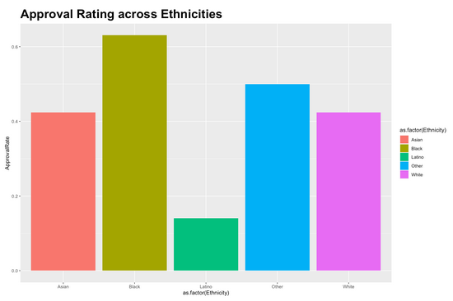
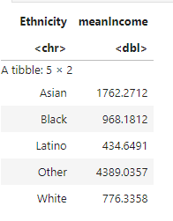
Dataset exploration(cont’)

Slide 10
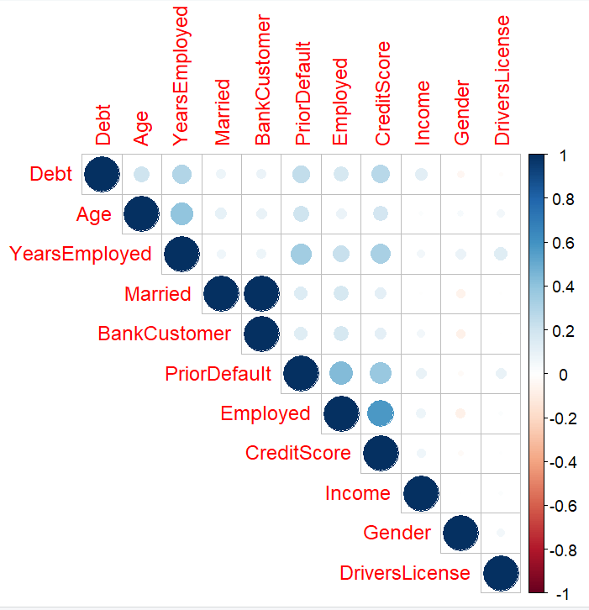
Dataset Exploration(Cont.’)

Slide 11
Variable Selection

Slide 12
Why do variable selection?
Reduce randomness and thus reduce overfitting of the models to the randomness
Easy to interpret and explain
Used two different methods
Notes:
According to investopedia, Credit represents an agreement between a creditor (lender) and a borrower (debtor). The debtor promises to repay the lender, often with interest, or risk financial or legal penalties.
Business needs credit to facilitate business activity, spend on capital expenditures, create jobs and thus indirectly stimulate the economy. Individuals need credit to fund major expenses, such as: education, real estates, autos, etc. Therefore, it is very important to facilitate lending in the economy without incurring excessive risks.

Slide 13
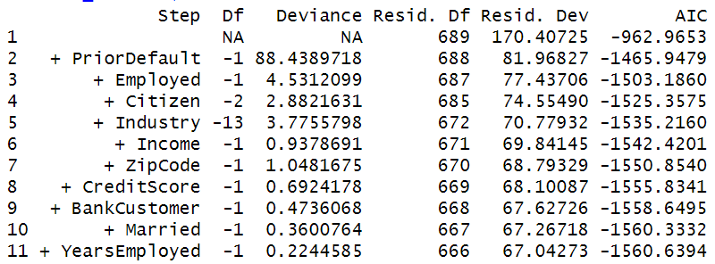
Forward Stepwise Regression
Modeling every 1 variable, 2 variable, .. n variable model
Calculate the AIC till no significant improvement is seen

Slide 14
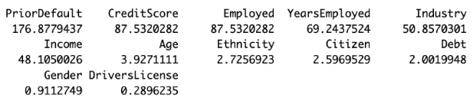
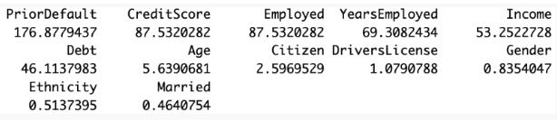
Classification & Regression Tree (CART)
Can generate simple and easy to explain model
Prone to overfitting and requires pruning

Slide 15
Outcome of Variable Selection
Identified six variable to use for our Credit Approval models
PriorDefault
CreditScore
Employed
YearsEmployed
Income
Debt

Slide 16
Principal Component Analysis
When dealing with high dimensional and correlated data
Removes correlations in data and ranks coordinates by importance
Select first n principal components we reduce randomness and they have a higher signal to noise ratio

Slide 17
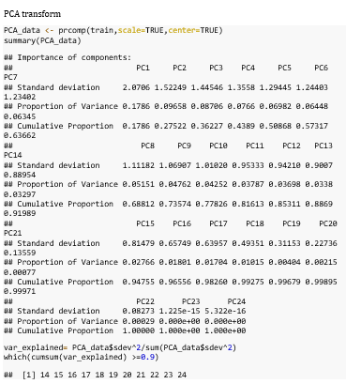
PCA Transform
First 15 components cover 90% of the variance

Slide 18
Logistic Regression Model

Slide 19
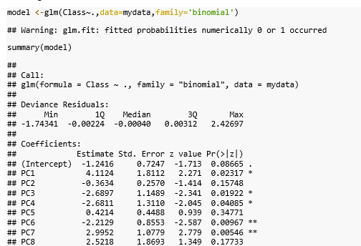
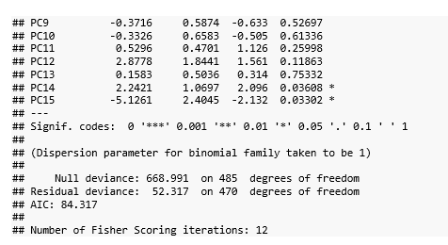
Logistic Regression Model
Notes:
Trang Slides- starting here

Slide 20
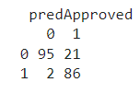
Logistic Regression (cont)
Confusion Matrix on training dataset

Slide 21
Neural Network Model
Notes:
Thank you Trang. My name is Aaron Beach, and I will present this part of our project related to the neural network model we chose to analyze our data. Credit risk analysis is a matter of predicting the probability that someone is too risky to lend to, which lends itself naturally to logistic regression. However, more and more, financial institutions are opting to employ neural networks in their lending decisions. which are better able to handle more complex data, and have been shown to provide better accuracy. There have historically been constraints to their usefulness in lending, but scientists have figured out how to overcome those constraints in recent years. In this section, I will explain the outcomes of a few tests we ran with a neural network model, and we’ll see whether or not this accuracy claim is true.

Slide 22
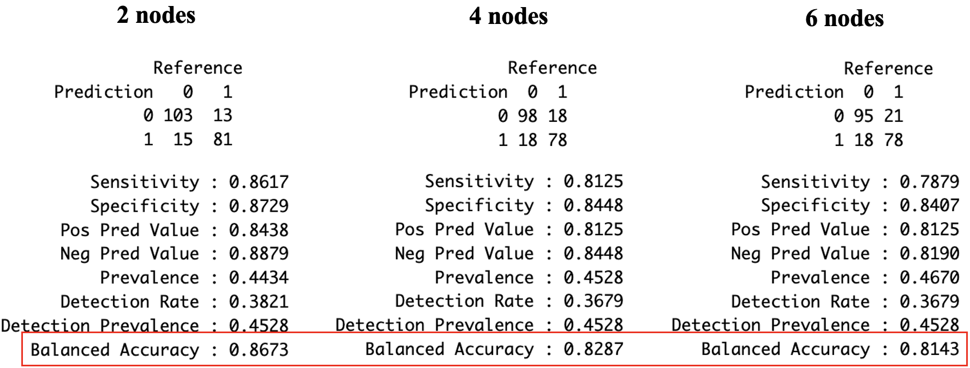
Neural Network
Notes:
To test the neural network model, the first step was to determine the best configuration of layers and nodes to use in our model. A neural network works by transforming input into output by passing the input through what are called hidden layers, each with a number of nodes. As it turned out, any more than one layer was not able to converge on a solution when we input the 6 variables that we focused on in our analysis. Focusing just on one layer, you can see that the accuracy decreased the more nodes we added, so for this analysis, we will focus just on a neural network with one layer and two nodes. On the next three slides, you will see this model applied to three different sets of input: 1 is the set of 6 variables we selected through our variable selection process, the next is the first 13 principal components that were determined to explain at least 90 percent of the variance, similar to what was used in the logistic regression, and the third was a combination of first selecting the 6 variables, and applying principal component analysis which limited the model to 5 principal components. We will go through each of these and observe their respective accuracies.

Slide 23
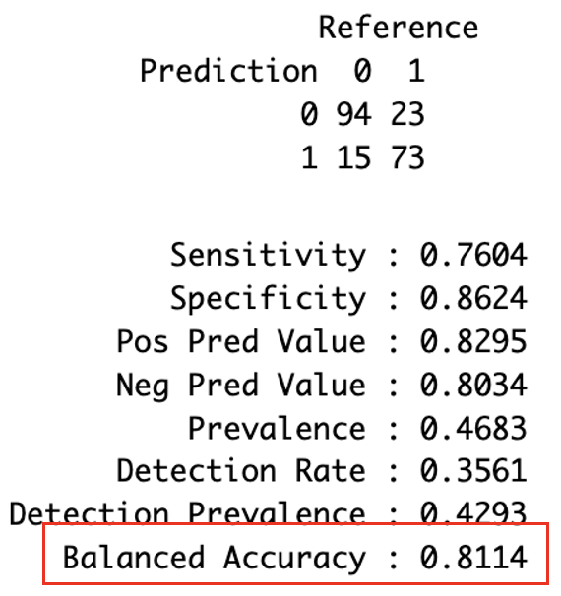
Neural Network (Cont.’)
Neural network modeling Approved vs 6 variables

Slide 24
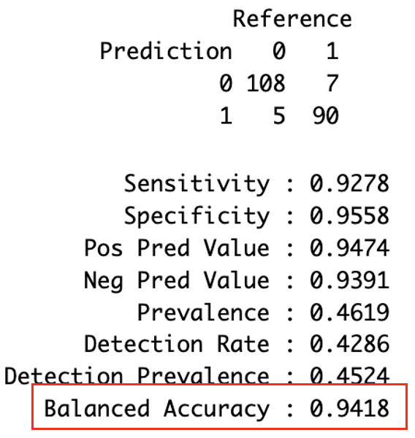
Neural Network (Cont.’)
Neural network modeling Approved vs 13 principal components built on original variables

Slide 25
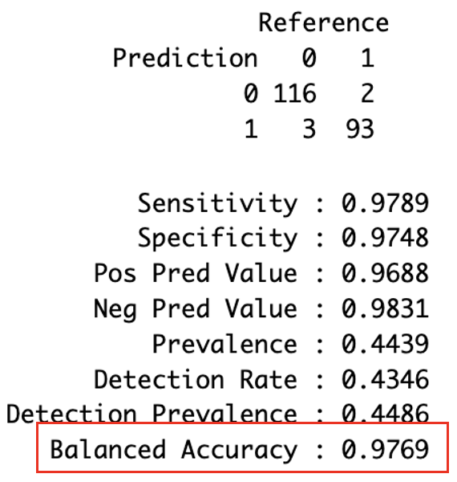
Neural Network (Cont.’)
Neural network modeling Approved vs 13 principal components built on 6 chosen variables

Slide 26
Neural Network (Cont.’)
Accuracy 0.8114
Accuracy
0.9418
Accuracy
0.9769

Slide 27
Conclusion

Slide 28
Summary
Credit decision analysis
Data exploration
Variable selection
Modeling
Download
Clean
Transform
Imputate
Forward stepwise regression
Principal component analysis
Logistic regression
Neural network

Slide 29
Take-home message
Neural network does not require data normalization
Neural network model predicts credit decision with high accuracy

Slide 30
Citation
[1] Seetharaman, K. (2018, February 22). Financial Applications of Neural Networks. Blog. Retrieved from https://www.aspiresys.com/banking-financial-services.
[2] Bartlett,Robert, Morse,Adair, Stanton,Richard and Wallace,Nancy. (2019,November). Consumer-Lending Discrimination in the Fintech Era. Retrieved from
http://faculty.haas.berkeley.edu/morse/research/papers/discrim.pdf?_gl=1*15rr2lu*_ga*MTMzMDc2OTExMi4xNjgwMDE3ODQ4*_ga_EW2RSBHHX6*MTY4OTg3ODc1NS4xLjAuMTY4OTg3ODc1NS4wLjAuMA..
[3] Statology.org. (2019, April 27). A Complete Guide to Stepwise Regression in R. Retrieved from https://www.statology.org/residual-plot-r/
[4] Frost, J. (n.d.). Multicollinearity in Regression Analysis. Retrieved from https://statisticsbyjim.com/regression/multicollinearity-in-regression-analysis/
[5] McBurnett, M. (2020, December 16). How Neural Network Models Put Financial Services Within Reach. Retrieved from https://www.equifax.com/business/blog/-/insight/article/neural-network-models-put-financial-services-within-reach//

Slide 31
Thank You!

